Slide 1
ONLINE FOOD DELIVERY SYSTEM

Slide 2
Group 6 – Project Members
PON VASANTH S
PRAKASH MURUGESAN
PRATEEK DUBEY
PRAVEEN KUMAR P
PRAYAGA VISWANTH
PREETHI SUNDARRAJ
RAGUL VS
RITESH KUMAR DWIVEDI
ROHITH X
STAR AJAYS SINGH SM

Slide 3
Abstract
An Online Food Ordering System is proposed here which simplifies the food ordering process. The proposed system shows an user interface and update the menu with all available options so that it eases the customer work.
Customer can choose more than one item to make an order and can view order details before logging off. The order confirmation is sent to the customer.
The order is placed in the queue and updated in the database and returned in real time. This system assists the staff to go through the orders in real time and process it efficiently with minimal errors.

Slide 4
Introduction
The "Online Food Ordering System has been developed to override the problems prevailing in the practicing manual system. This software is supported to eliminate and in some cases reduce the hardships faced by this existing system. Moreover this system is designed for the particular need of the company to carry out operations in a smooth and effective manner.
The application is reduced as much as possible to avoid errors while entering the data. It also provides error message while entering invalid data. No formal knowledge is needed for the user to use this system. Thus by this all it proves it is user-friendly. Online Food Ordering System, as described above, can lead to error free, secure, reliable and fast management system.
MyDelivery

Slide 5
Objective
Create a dynamic and responsive online food delivery web application for online ordering of food items of different cuisines from a restaurant.
The following are the major objective of this application.
To provide a bug-free Online Food Delivery system to Users as well as Admin.
The main objective is here to provide a nice and secure platform for Ordering Food.
To maintain the records of Product, Category available into the system.

Slide 6
Functionality
Below are the key responsibilities and functionalities to be implemented in the admin portal.
Admin user:
Login to portal
Create Admin Account
Add or remove cuisines to or from the application to build a rich product line.
Edit food item details like name, price, cuisine, description, and offers to keep it aligned to current prices.
Enable or disable food items.

Slide 7
Functionality
Below are the key responsibilities and functionalities to be implemented in the user portal.
End user:
Register to the application
Change password
Update Profile
Sign into the application to maintain the record of activities
Search for food items based on the search keyword
Apply filters and sort results based on different cuisines to get the best deals
Add all the selected food items to a cart and customize the purchase at the end
Perform a seamless payment process.

Slide 8
Tools and Technology
F
Front-End
S
Server-side
B
Back-End
T
Testing
Angular
Spring Boot, JPA, Tomcat
MYSQL
J-unit, Postman, Rest Client Chrome

Slide 9
Environment
Visual Studio, Eclipse, Postman and MySQL to be installed to the system.
4 GB Random Access Memory.
800 MB of Free Space on Hard Disk.
Microsoft Windows XP or Linux or Equivalent OS.
Web Browser.

Slide 10
Modules
Login
User
Admin
Payment
Managing the login details
Used for Ordering the food
Perform a seamless payment process
Managing the food details

Slide 11

Individual Contribution

Slide 12
Login and Register
Frontend – Praveen Kumar P
Create an components as signup and sign In for Admin and User.
In the ts file we created the reference form Group as we know form Group is one or more combination of form Control, then ts file created a method name sign in and signup and created an object for an method to store value of the reference.
In Service method check whether the method name or not and the method will check backend part then every is fine it will again come to ts file and then it will check three parameters of subscribe after will execute.
After everything fine, then will get appropriate message.

Slide 13
Change Password and Update Profile
Frontend – Ragul V S and ajay
Create an components as change password and update Profile for User.
In the ts file we created the reference form Group as we know form Group is one or more combination of form Control, then ts file created a method name change password and update profile and created an object for an method to store value of the reference for user.
In Service method check whether the method name or not and the method will check backend part then every is fine it will again come to ts file and then it will check three parameters of subscribe after will execute.
After everything fine, then will get appropriate message and execute.

Slide 14
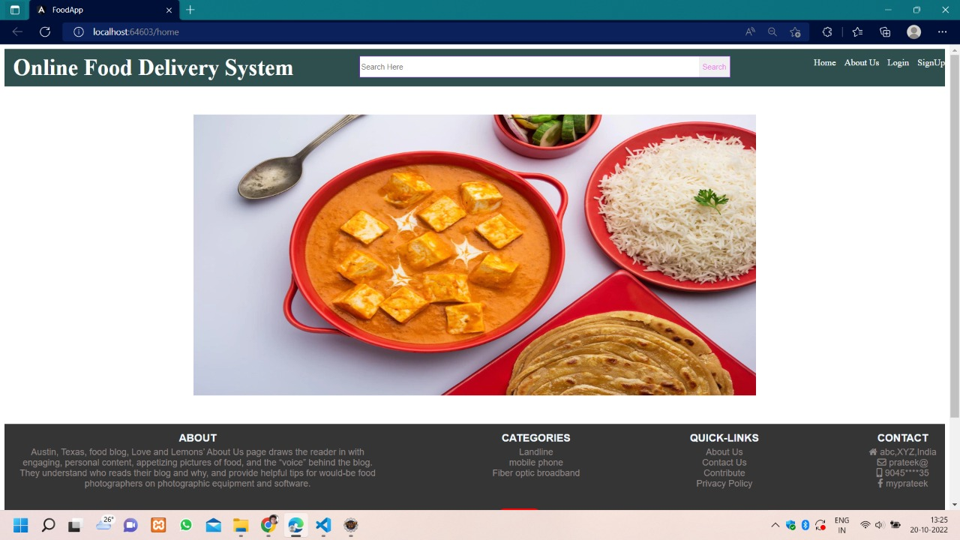
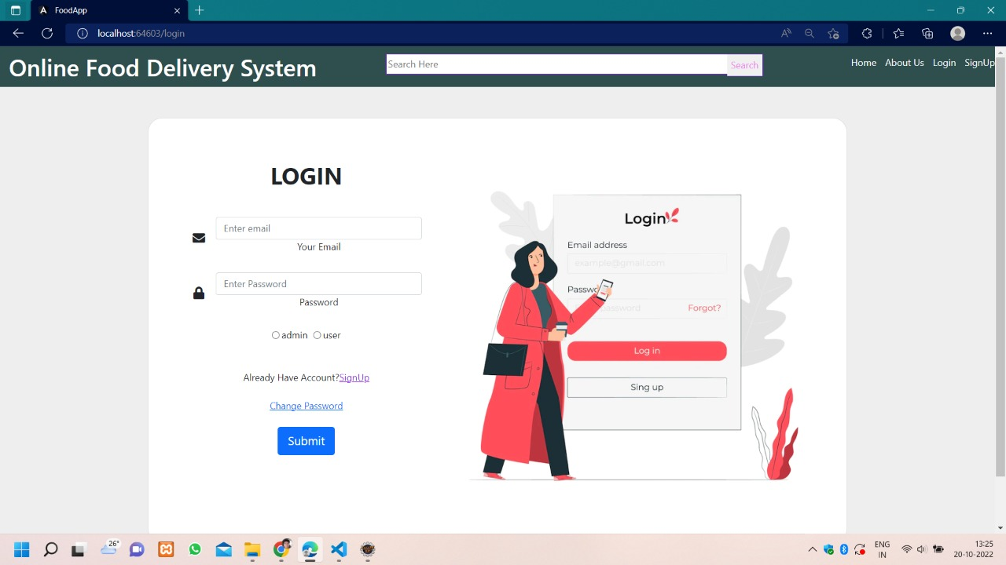
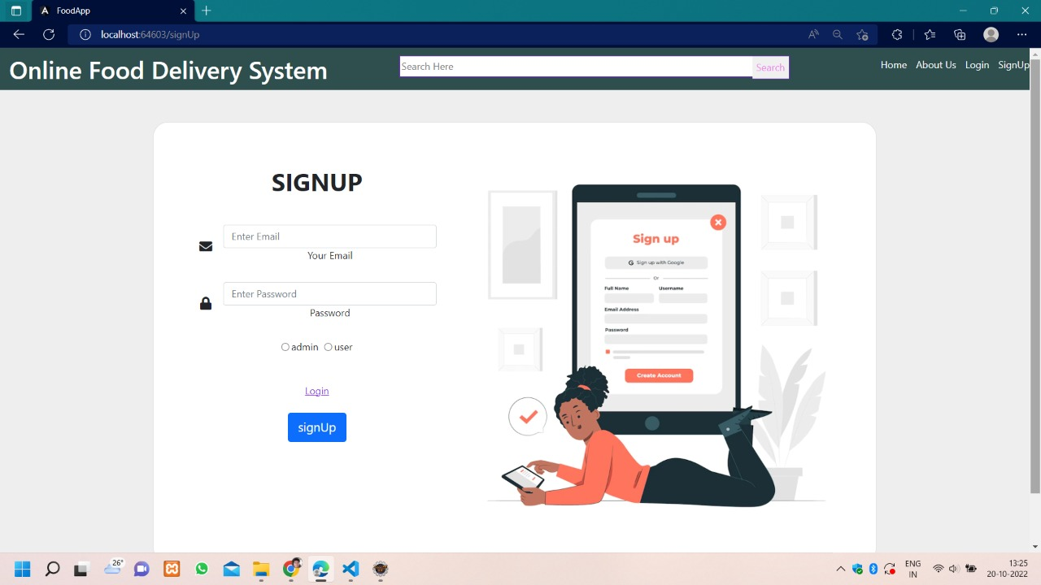
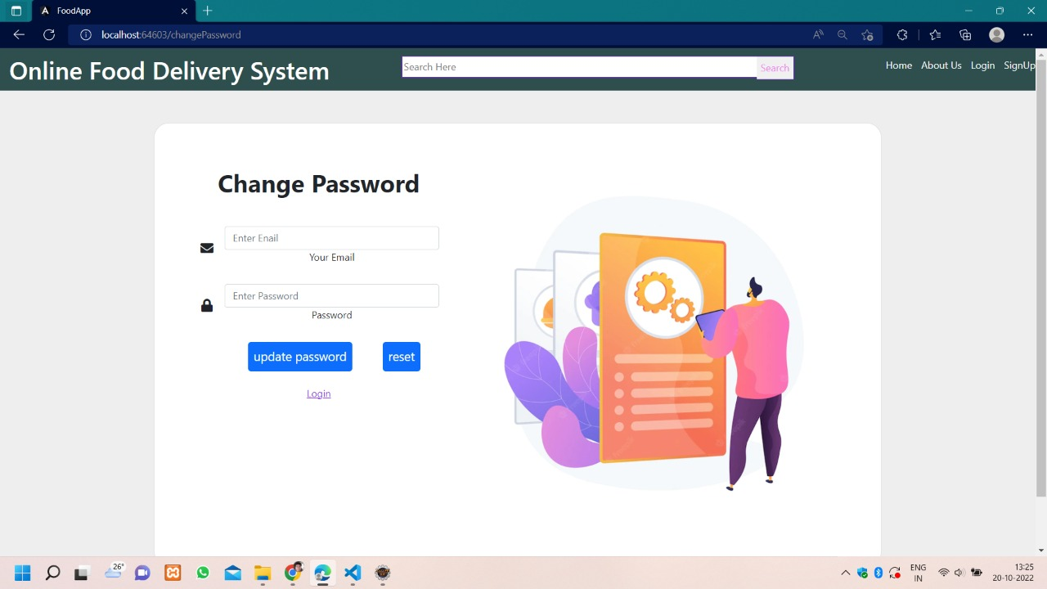

Slide 15
Admin And User - Frontend
Admin side , backend fid concept and rest client testing – Ragul V S
Created class for Mapping frontend and backend database
Created service class for food and created storeFood, updatefood, findallfood, deletefood, findfoodbyname, findfoodbycuisines methods according to admin requirements .
Created components for add food and in ts file importing service for accessing methods and html page for form display
Created component for view food and in ts importing service class for accessing methods and html file for display forms.
Created component for admindashboard . In html page provided routerlink ,router outlet and logout.
In ts file importing router for navigation.Created cuisines class for Mapping with database table .
Created service class for cuisines and created storecuisines,deletecuisines, deletecuisinesbyid,findallcuisines methods.

Slide 16
Admin And User - Frontend
Created addcuisine component, in ts file imported service class for accessing methods and in html for display
Then app.routing.module.ts importing all components and created path of all components
Then in app.component.html page router-outlet provided.
User side – Prateek
We have various functionalities here user can view and search the food items .
If the user will click on the view all item than list of all food item will appear on the screen.
User can also pay the money using pay now button.

Slide 17
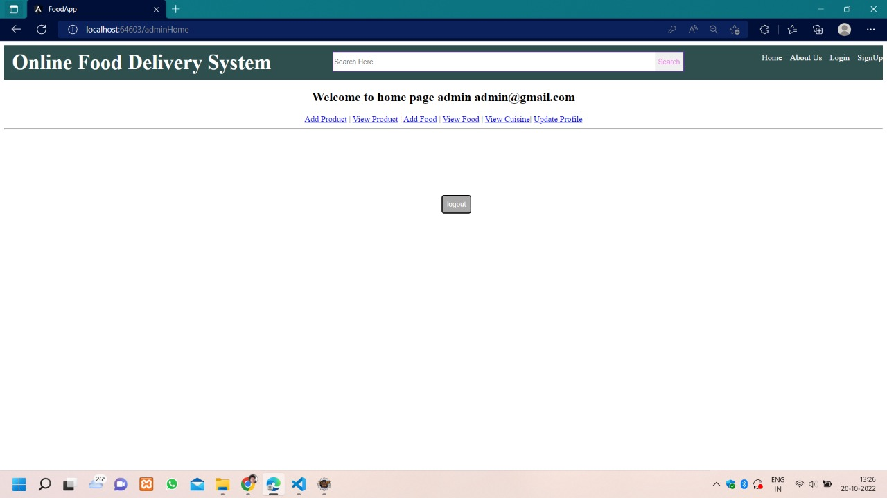
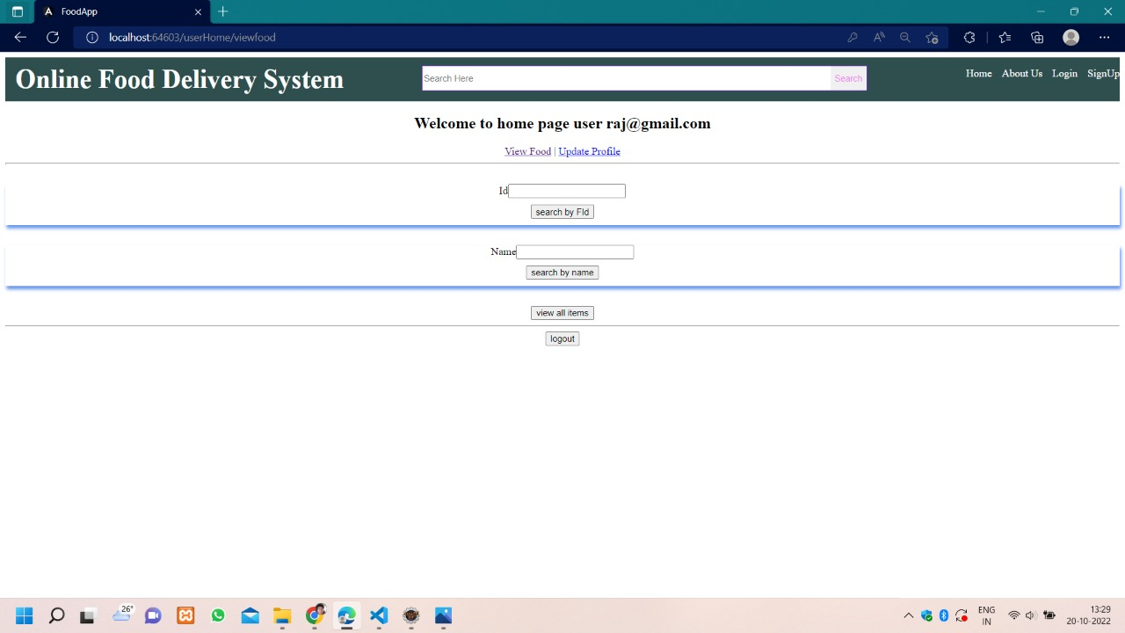
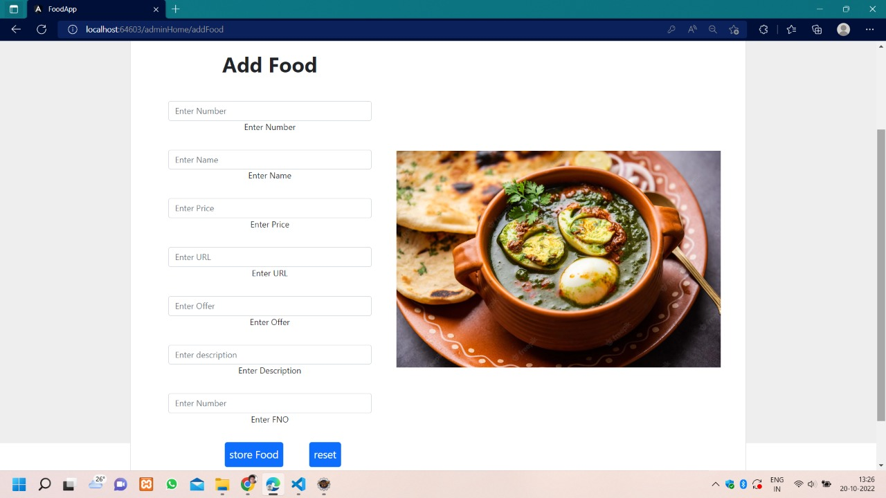
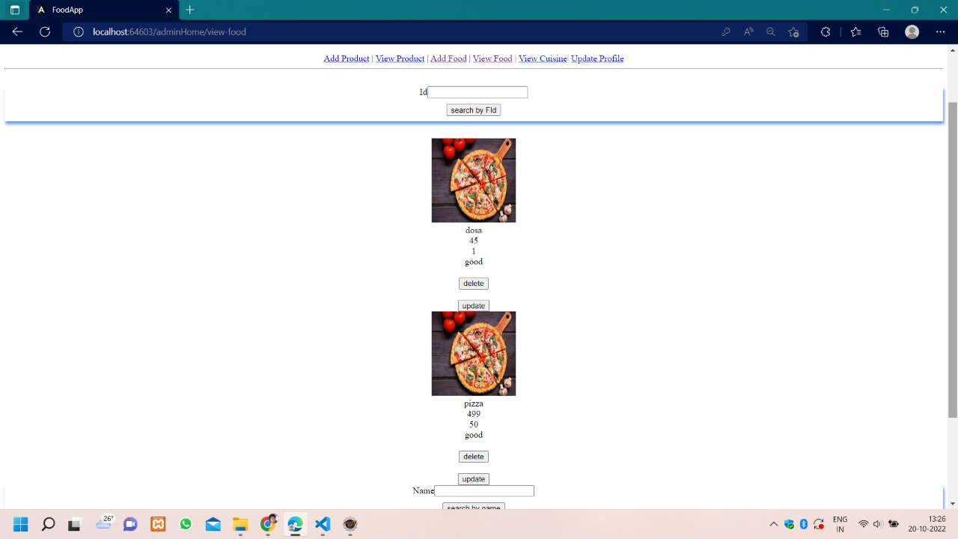

Slide 18
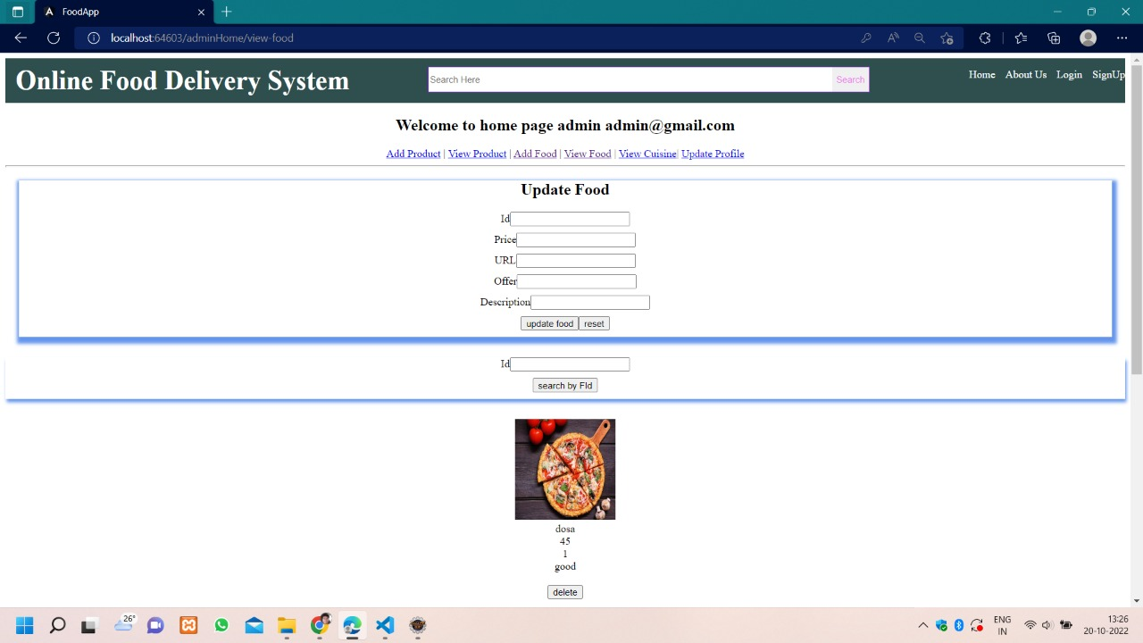
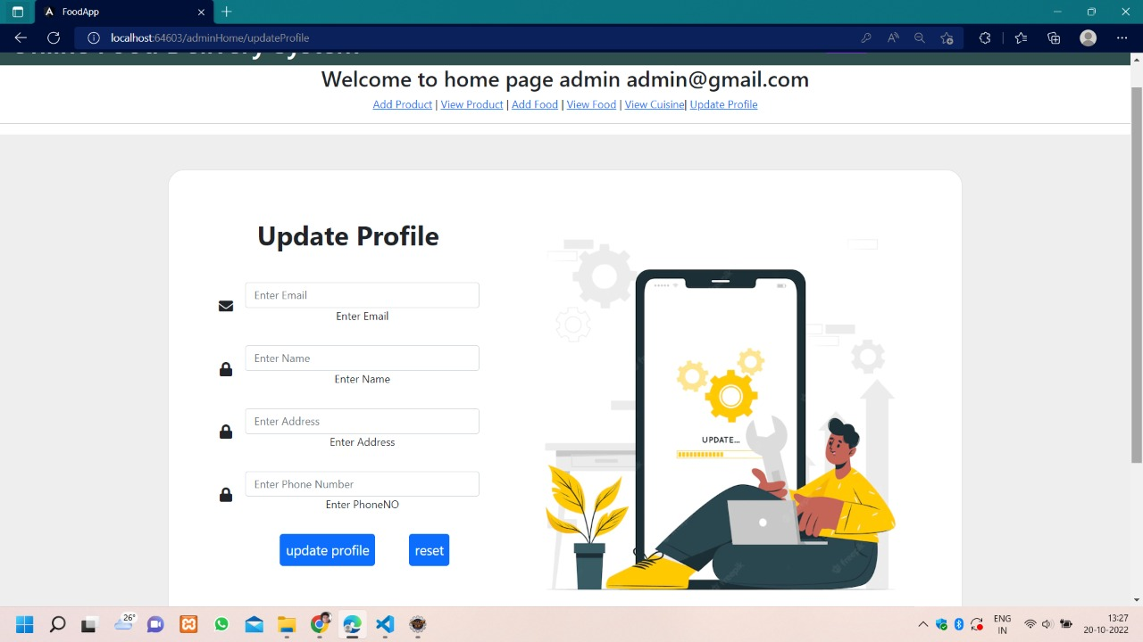
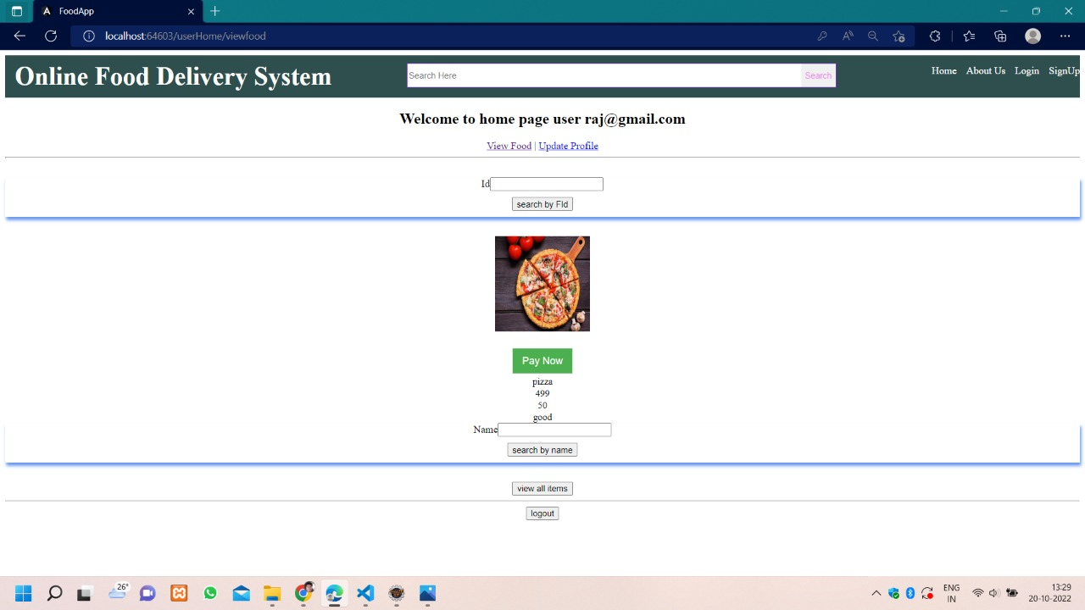

Slide 19
Payment -Frontend
20%
$50.00
31-50
18-30
Payment , add to cart , styling , cuisines - Rithesh
Declare a variable called Razorpay as any type.
Declare a variable called options with all the parameters required for the Razorpay checkout.
Creates an instance of Razorpay with the options and calls Razorpay.open() method to initiate the payment process.
Defines a handler function for the payment.failed event in order to log the error details and show failure reasonin the page in case of payment failure.
Defines a function called onPaymentSuccess and binds the payment.success event with this function using the @HostListenerdecorator.

Slide 20
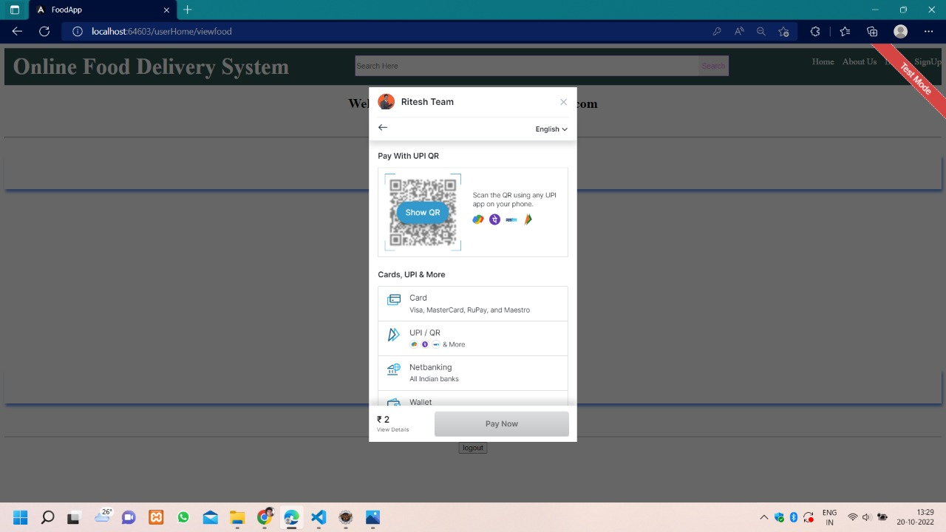
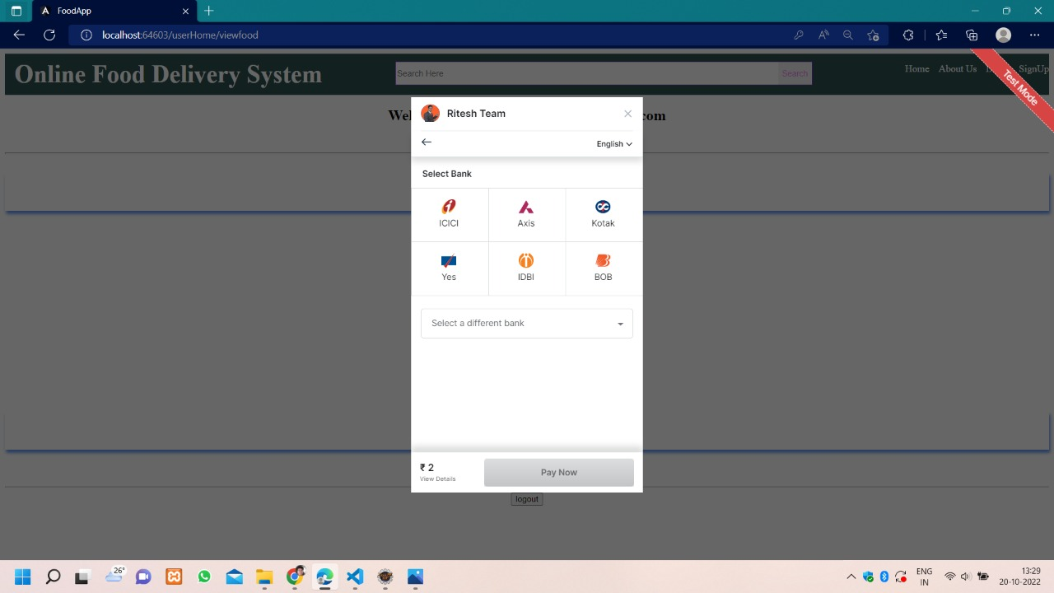
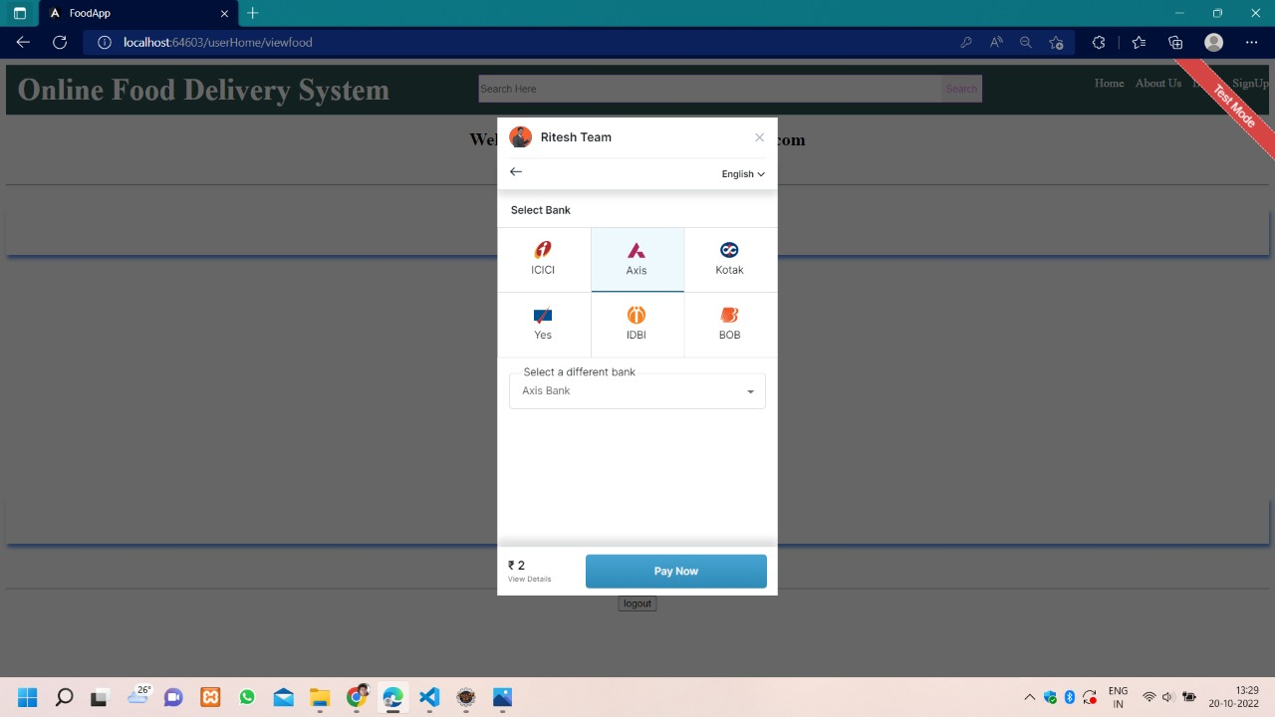
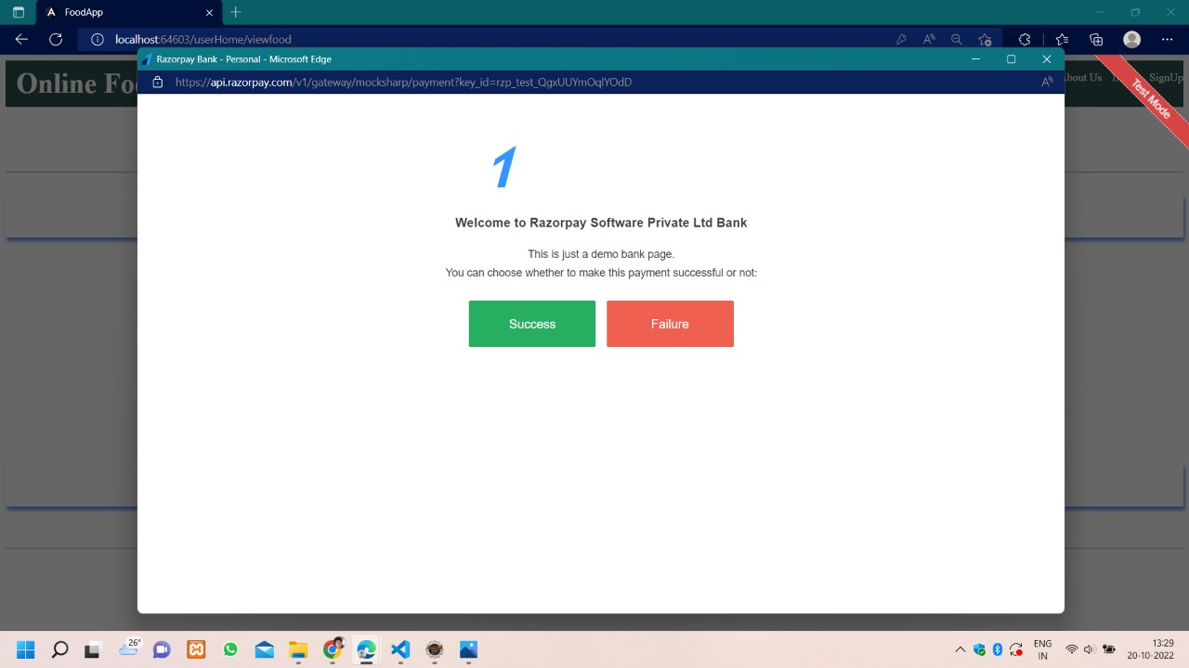

Slide 21
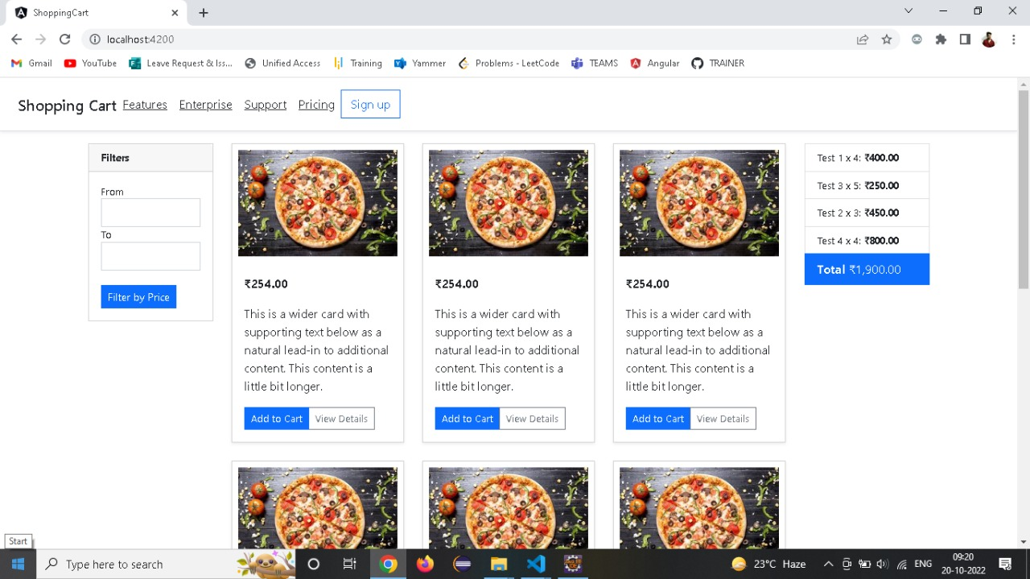
Add to Cart

Slide 22
Login and Register
Backend – Prakash
Created bean class for login.
Declaring instance variables. And generating getter setter and two string for this variables
Created interface repository thats extends JPA repository passing two arguments
Created service class for business logic and creating signin , signup , methods and written logics
Then created controller class for creating rest API for methods in service class.
Application.properties for connecting database and mentioning port.

Slide 23
Change Password and Update Profile
Backend – Vasanth
First in login class we are going to declare email,password,phone,name,phone number as instant enables
In login repo we are using jnterface which extents jp repository
In JP REPO we are passing 2 parameters login and stringString is basically email id s wrapper class
For login the parameter we are using is add class()In login service we are going to create a class for update pass word
Which passes through loginIn optional login we are going to search through id in #find_my_id
If the given email id is present in the database the result() is present And it will be stored in L variable through get set functionIf L.getpassword = Login.GetpasswordIs true we can enter new passwordIf no l.SETpassword
We are going to set it as a the password and then we are going tk use save and flush to save in VARIABLE L

Slide 24
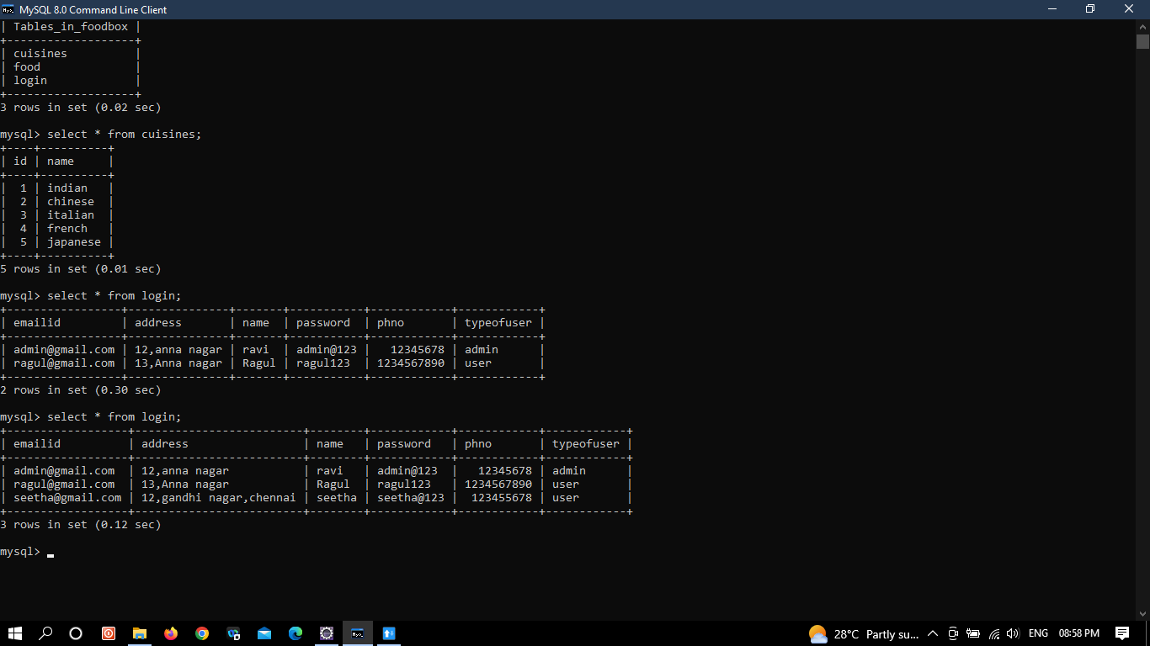
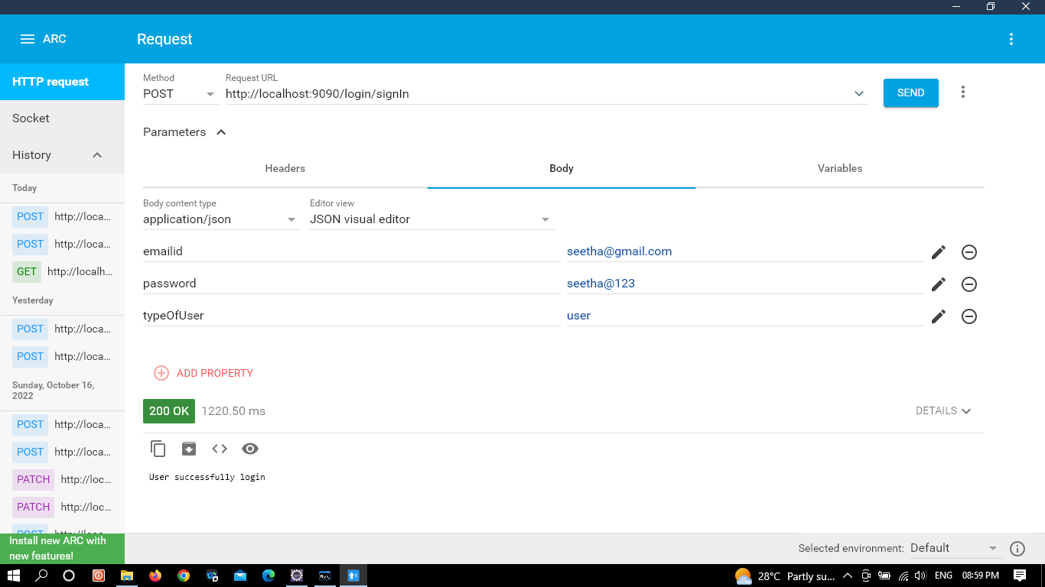
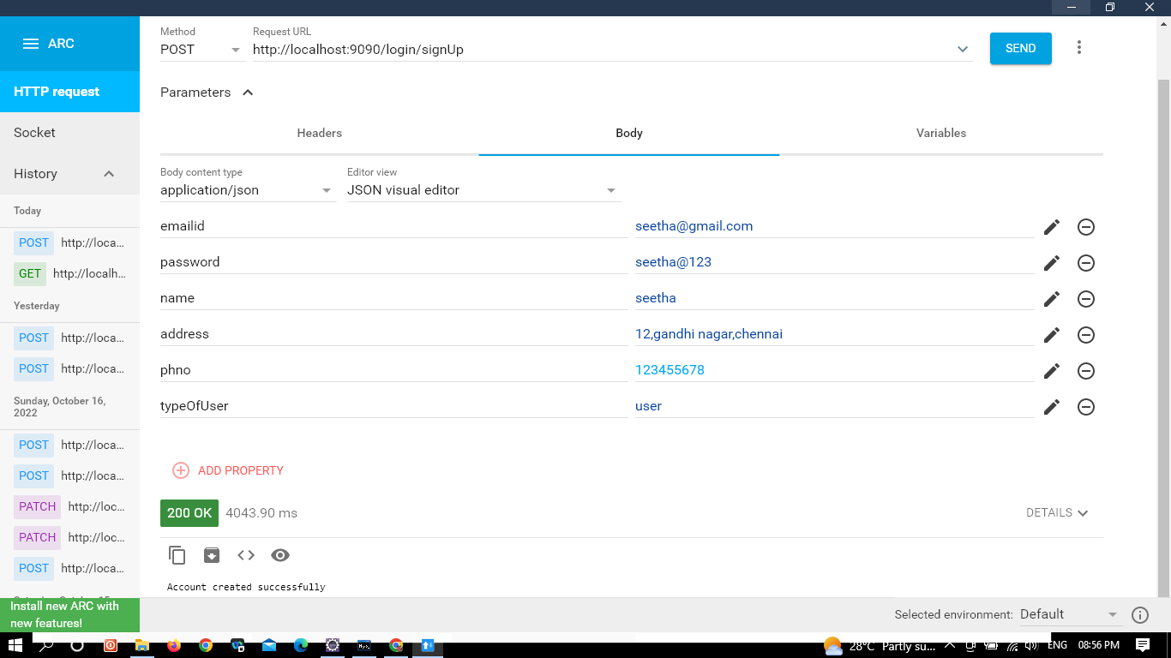


Slide 25
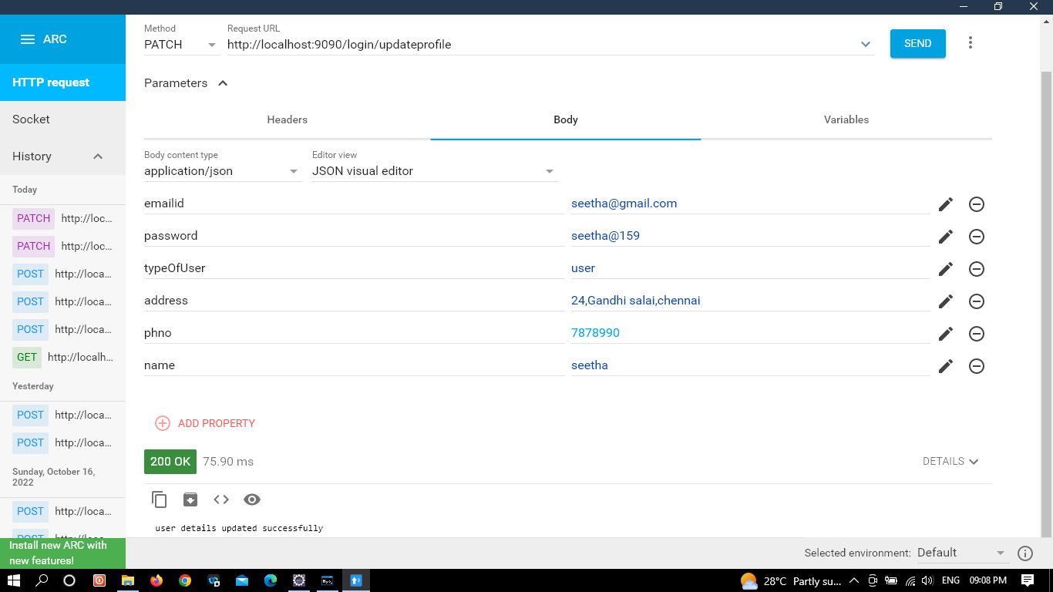




Slide 26
Food Side
Backend food , some frontend and rest client testing – Preethi
Created bean class for food.
Declaring instance variables. Getter setter and two string for this variablesCreated interface repository thats extends JPA repository passing two arguments
Created service class for business logic and creating storeFood , getAllFood , findFoodByCuisine, findFoodByName, updateFood, deleteFood methods and written logics
Then created controller class for creating rest API for methods in service classApplication.properties for connecting database and mentioning port.
Using rest client chrome for testing the rest api.

Slide 27
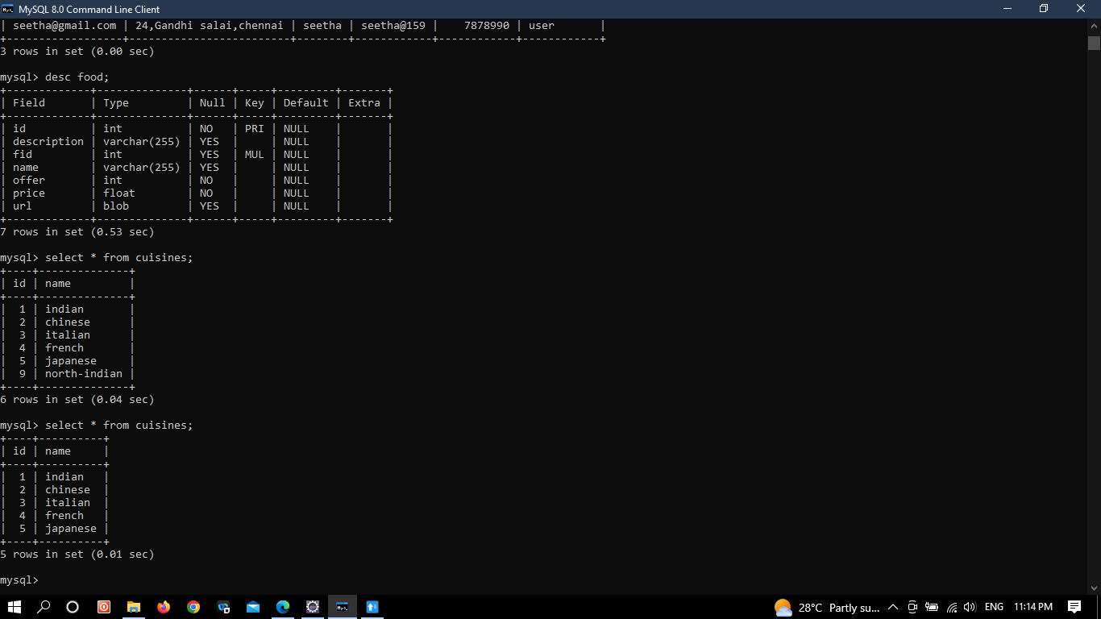
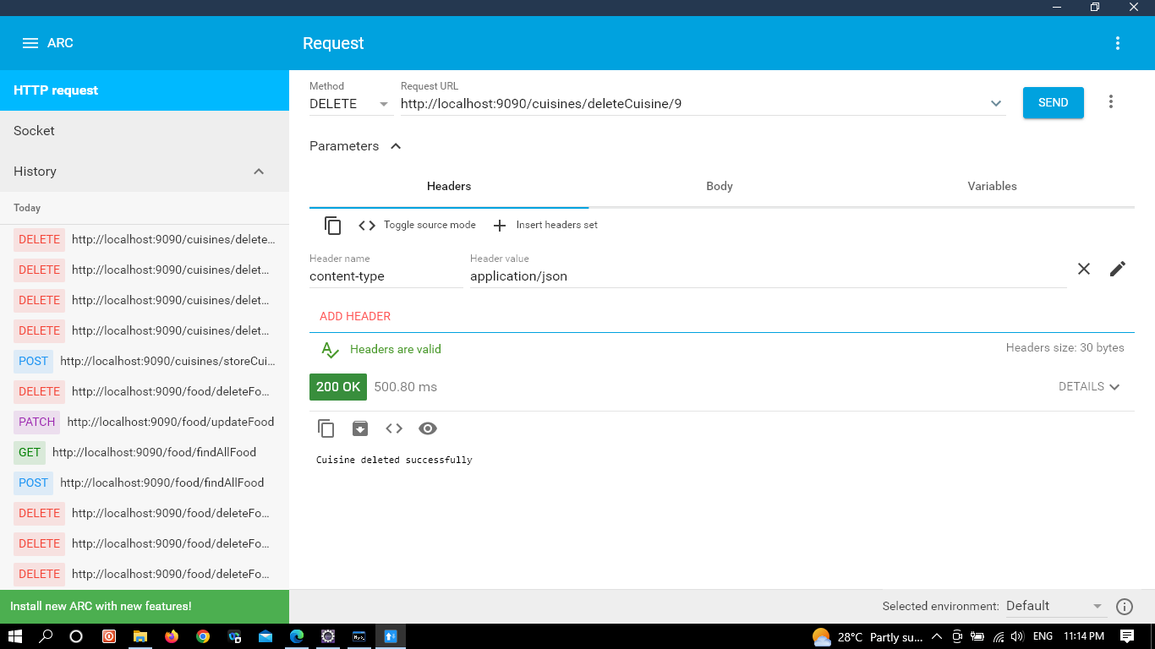
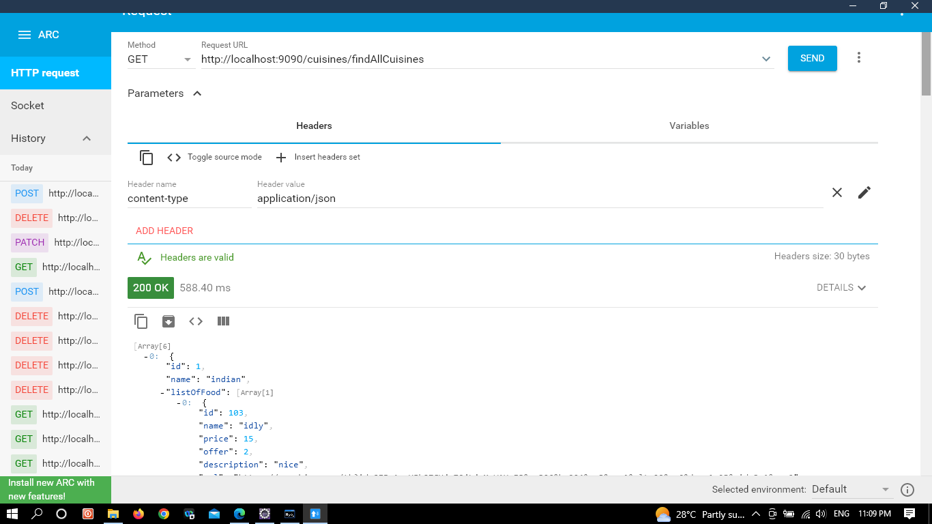
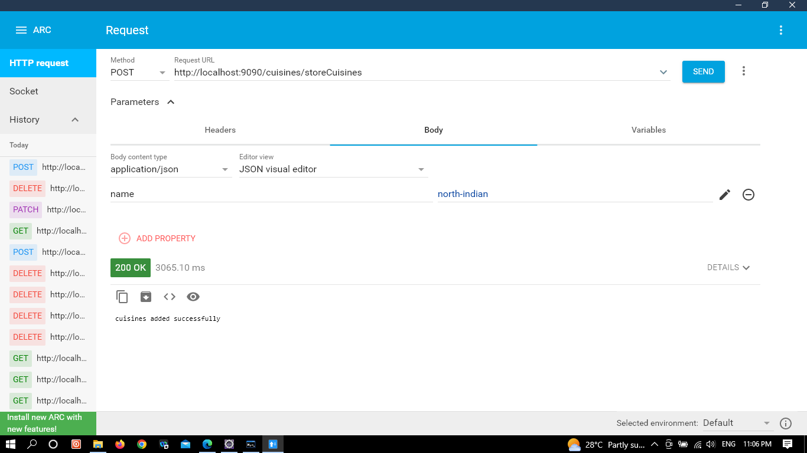

Slide 28
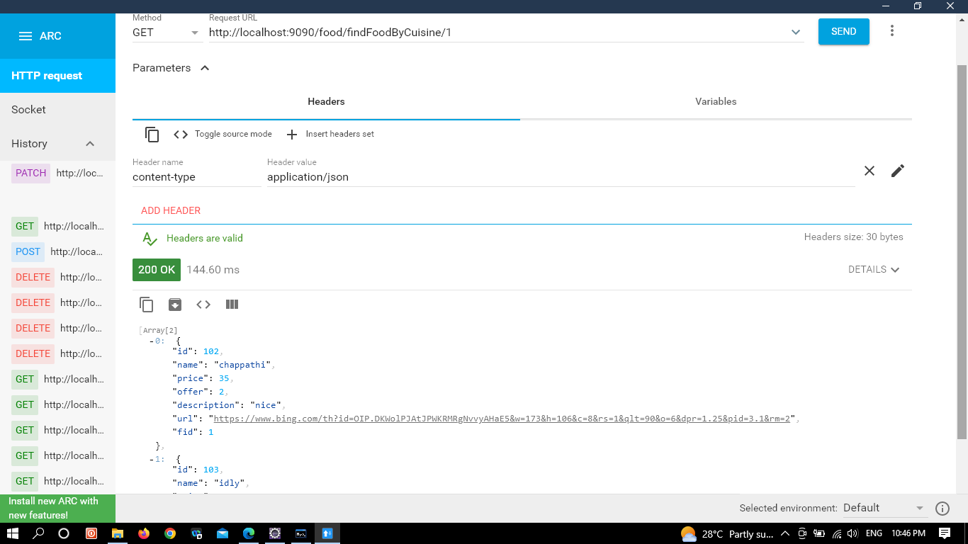
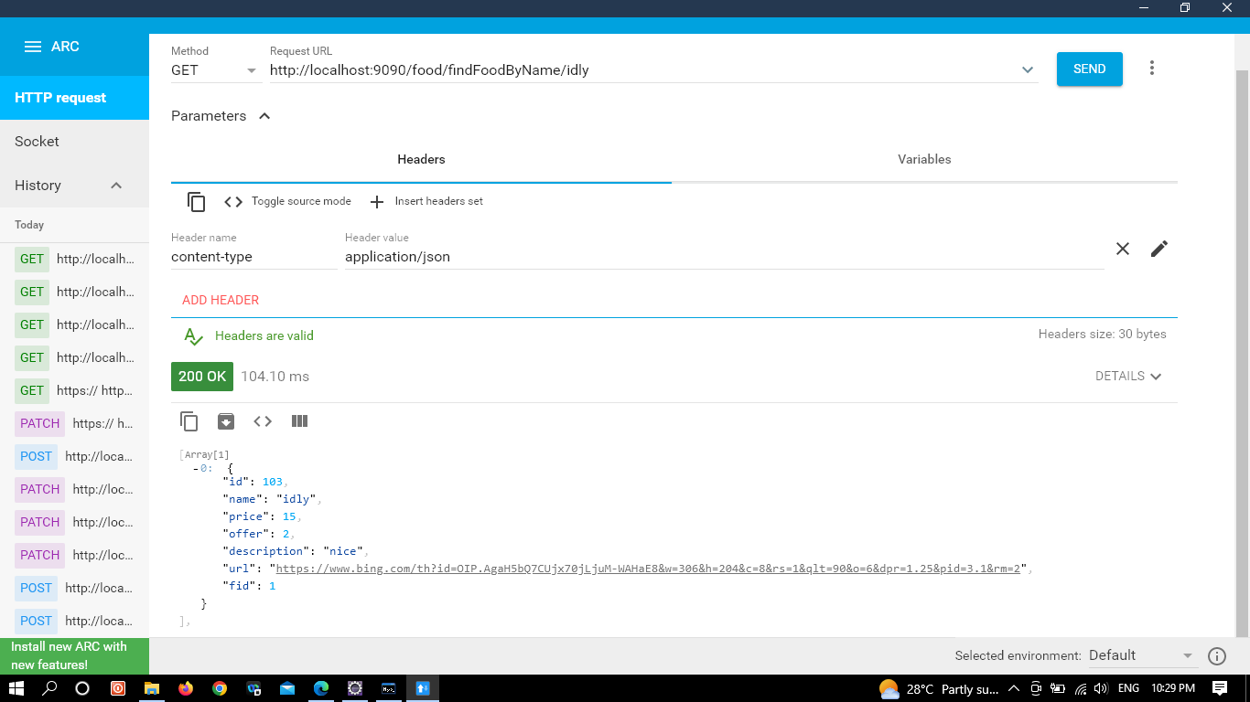
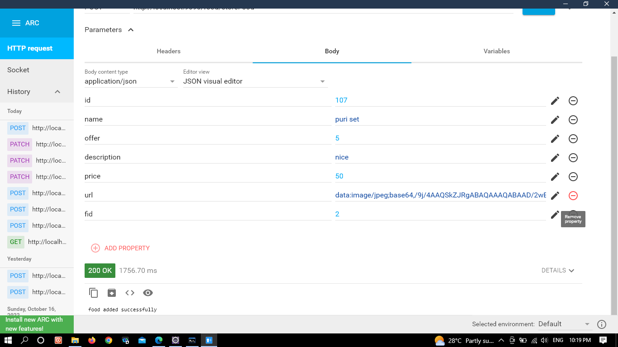
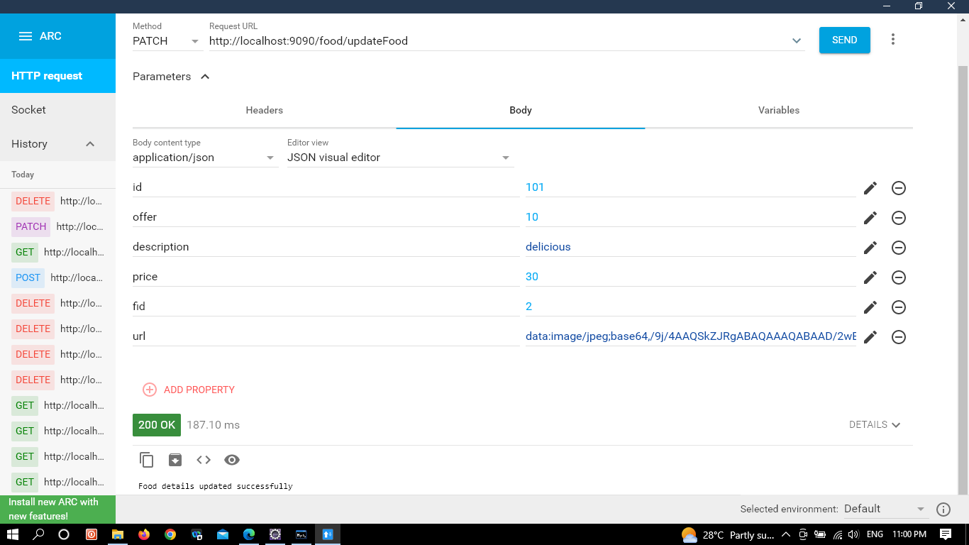

Slide 29
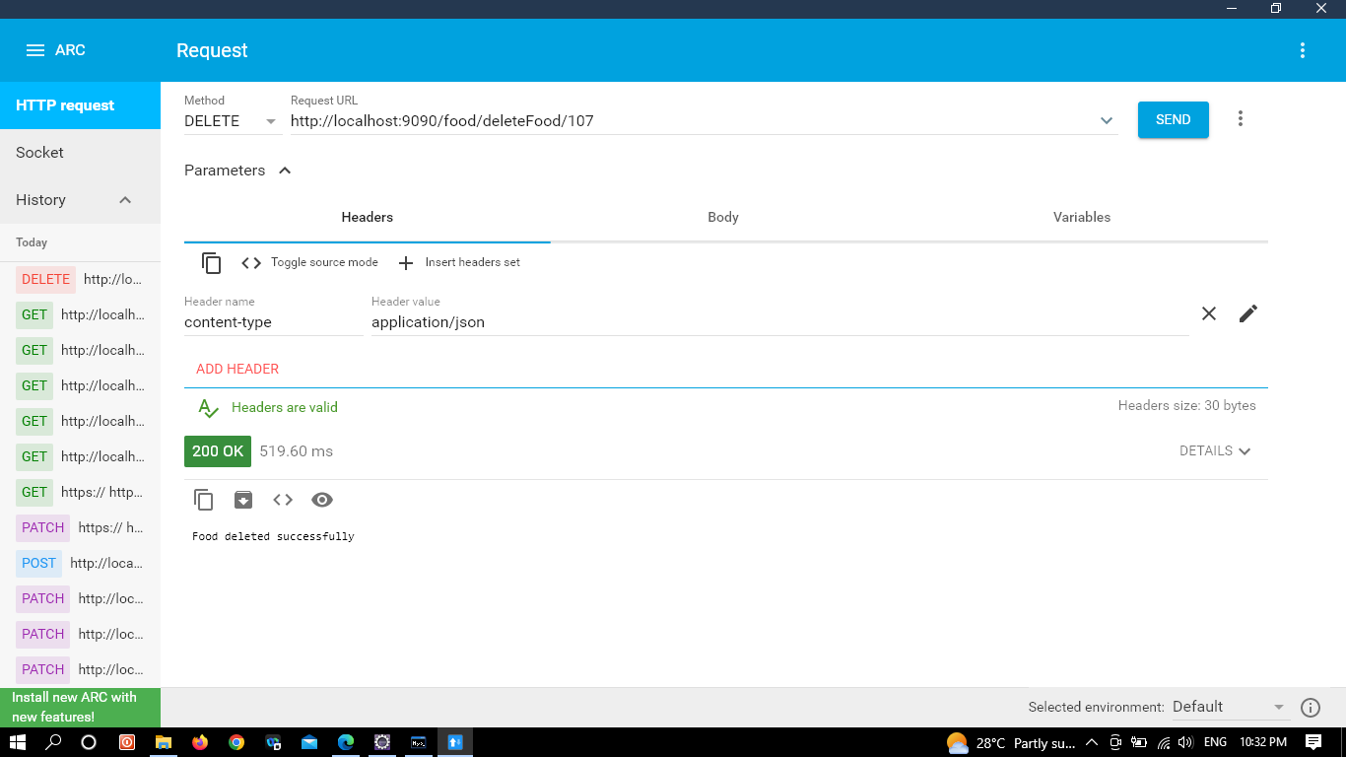
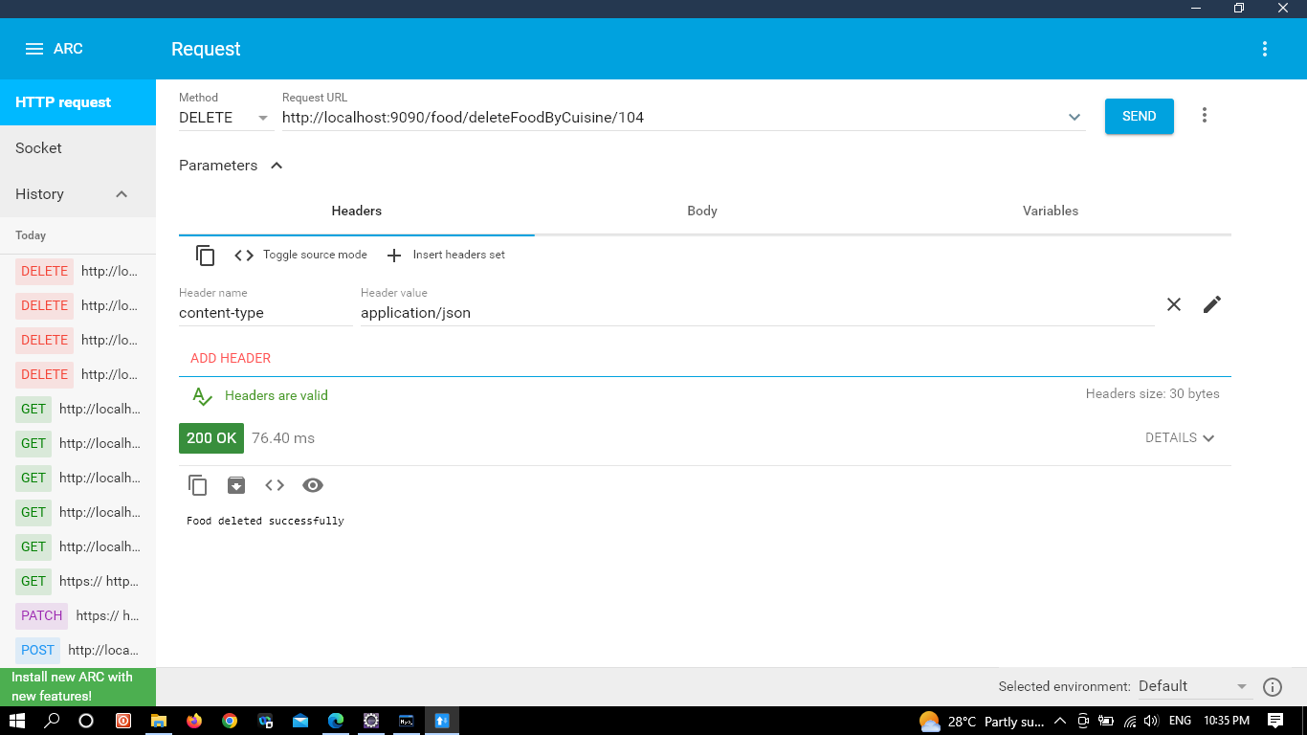
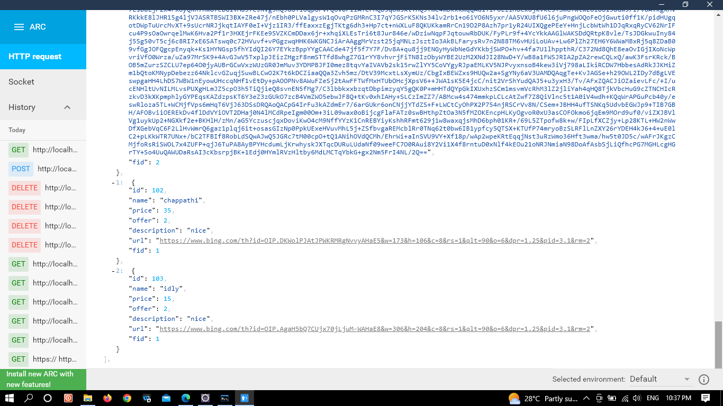

Slide 30
Testing
Testing-Viswanth and Rohith and backend
Testing is a procedure that makes sure the software meets the standard set by the requirements specification and operates smoothly with the fewest number of bugs as feasible.
A variety of tools and annotations are offered by Spring Boot to make testing your application easier.
Two modules are used to provide tests: spring-boot-test contains the essential components, and spring-boot-test-autoconfigure supports test auto-configuration.
As per testing in our spring boot project is concerned there are 2 types of testing.
J-Unit Testing
Rest-Api Testing
You can use the JUnit framework to call a method and verify (or assert) that the output is what you expected.For Unit Testing we need an annotation called @test which comes from JUnit Dependency.

Slide 31
Rest-API Testing
REST API Testing is open-source web automation testing technique that is used for testing RESTful APIs for web applications.
The purpose of rest api testing is to record the response of rest api by sending various HTTP/S requests to check if rest api is working fine or not.
Rest api testing is done by GET, POST, PUT and DELETE methods.

Slide 32
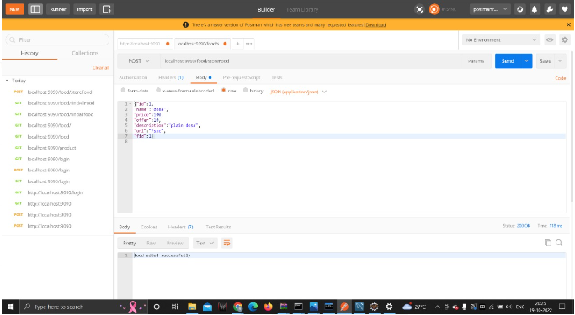
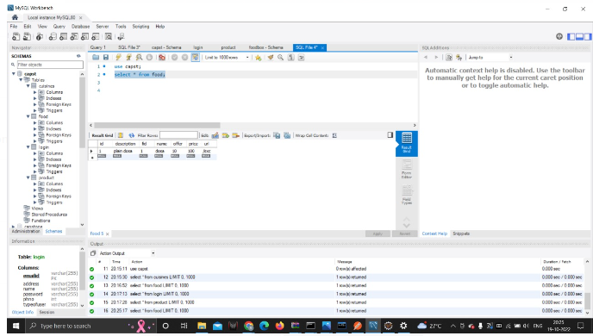
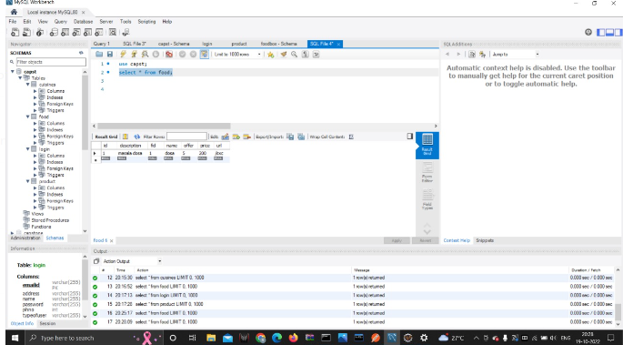
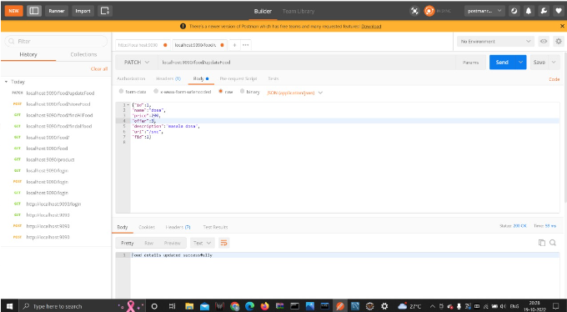

Slide 33
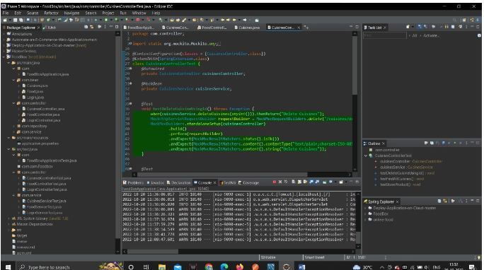
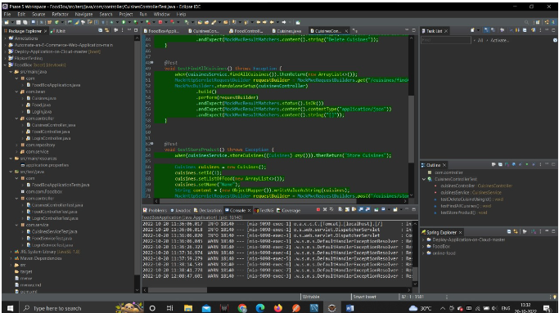
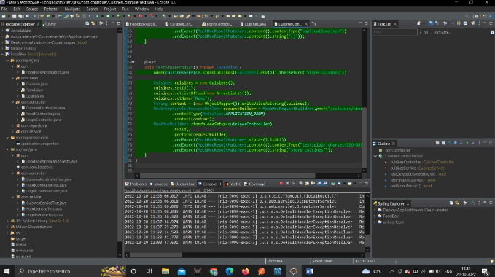
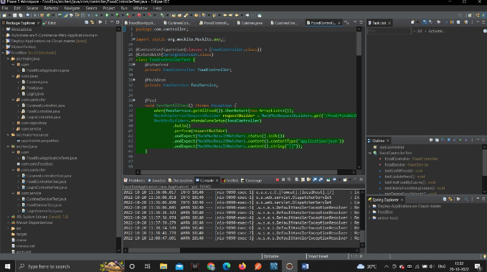

Slide 34
Thank You

